Slide 2
I Kings
chapter 17

Slide 3
Ahab did more evil in the eyes of God than any of those before him.

Slide 4
1 Kings 16:33
Ahab did more to provoke the Lord, the God of Israel, to anger than all the kings of Israel who were before him.

Slide 5
He raised up one person

Slide 6
“The making of a man of God,”

Slide 7
What does the name Elijah mean?

Slide 8
What does the name Elijah mean?
“el” stands for Elohim, or God
“I” my or mine
“Jah” comes from Jehovah

Slide 9
The name means:
“The Lord is Jehovah.
My God is Jehovah.
The Lord is my God.”

Slide 10
1 Kings 17:1
“Now Elijah the Tishbite, from Tishbe in Gilead,”

Slide 11
1 Kings 17:1
“Now Elijah the Tishbite, from Tishbe in Gilead,”
“He said to King Ahab, ‘As the
LORD, the God of Israel, lives, whom I serve,’

Slide 12
1 Kings 17:1
“The Lord who lives, whom I serve,” he says, “there will neither be dew nor rain in the next few years except at my word.”

Slide 13
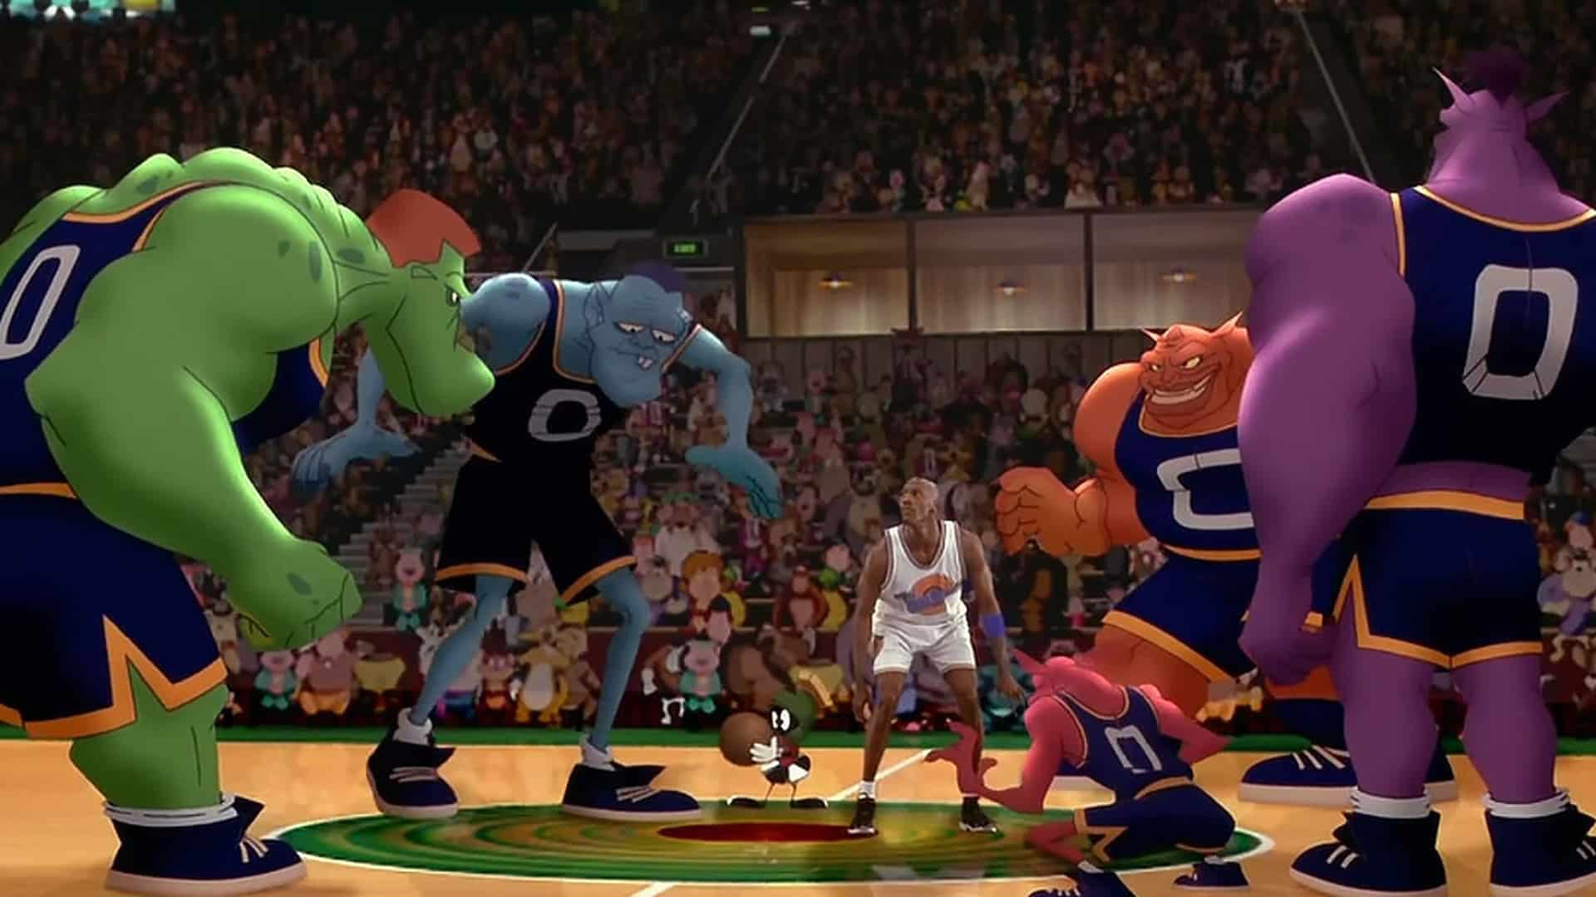

Slide 14
God shapes this man in a very deep season of preparation

Slide 15
For God to use you, first he has to prepare you

Slide 16
Three seasons of Preparations:

Slide 17
Three seasons of Preparations:
Season of isolated pain

Slide 18
1 Kings 17:2-3
“Then”

Slide 19
1 Kings 17:2-3
“Then”
“The word of the LORD came to Elijah: ‘Leave here, turn eastward and hide in the Kerith Ravine, east of Jordan.’“

Slide 20
Kerith

Slide 21
Kerith
“cut off”
or
“cut down”

Slide 22
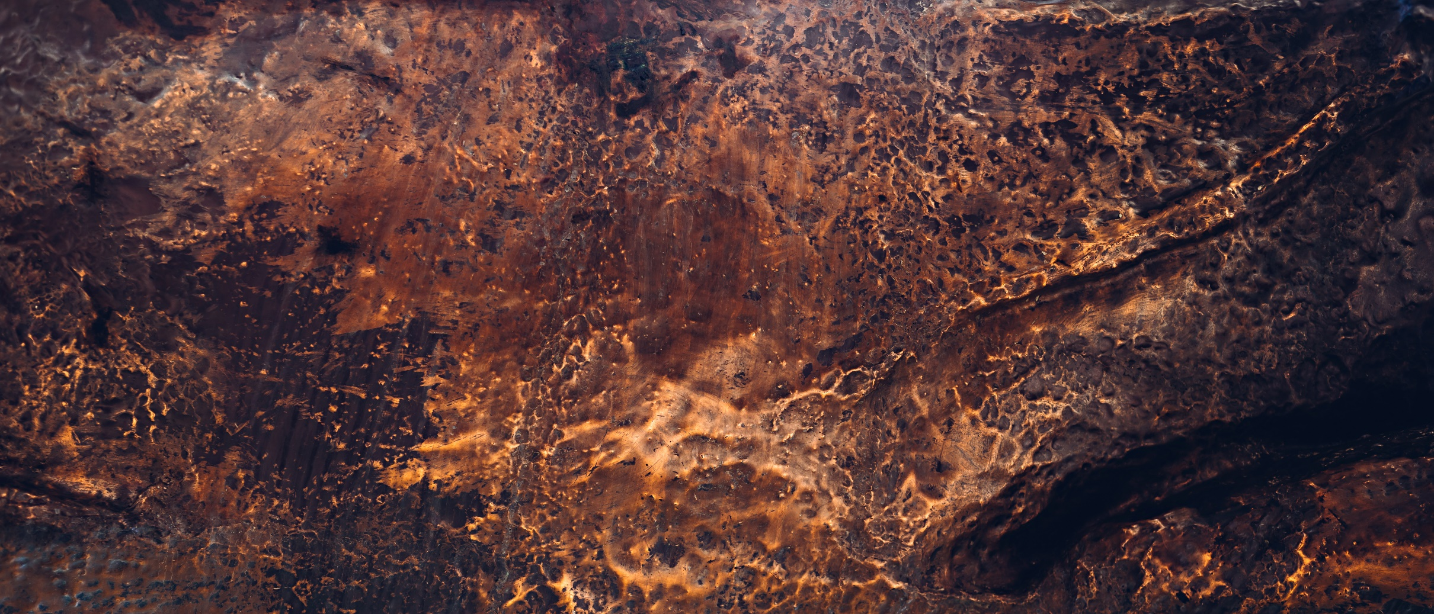
A. W. Tozer
“It’s doubtful that God can bless a man greatly until He’s hurt him deeply. It’s doubtful that God can bless a man greatly until He’s hurt him deeply.”

Slide 23
Three seasons of Preparations:
Season of isolated pain
2. Season of total dependence

Slide 24
1 Kings 17:4-6
“Elijah, you will drink from the brook that I have ordered the ravens to feed you there. So he did what the LORD
had told him. He went to the Kerith Ravine, east of Jordan, and stayed there. The ravens brought him bread and meat

Slide 25
1 Kings 17:4-6
in the morning, and bread and meat in the evening, and he drank from
the brook.”

Slide 26
Three seasons of Preparations:
Season of isolated pain
2. Season of total dependence
3. Season of unconditional obedience

Slide 27
1 Kings 17:7
“Some time later,

Slide 28
1 Kings 17:7
“Some time later, the brook dried up because there had been no rain in the land. Then the word of the LORD came to him: “Go at once to Zarephath of Sidon and stay there.”

Slide 29
God may cause the brook to
dry up to give us the courage to leave where we are and to go
where we are supposed to be

Slide 30
God may cause the brook to
dry up to give us the courage to leave where we are and to go where we are supposed to be

Slide 31
People say
“God guides by what He provides,”

Slide 32
Preachers say
“Where there is vision, God
gives the provision,”

Slide 33
God also guides by
what He does not provide

Slide 34
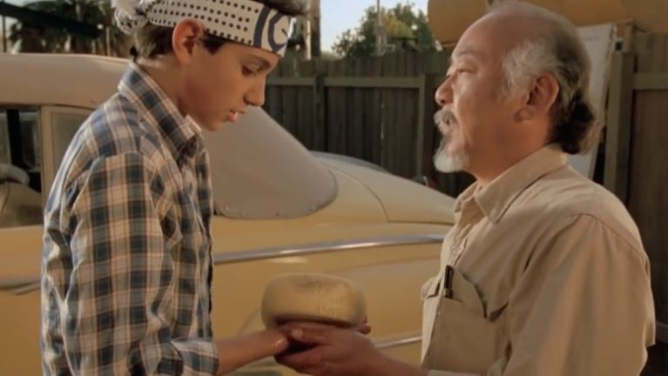

Slide 35
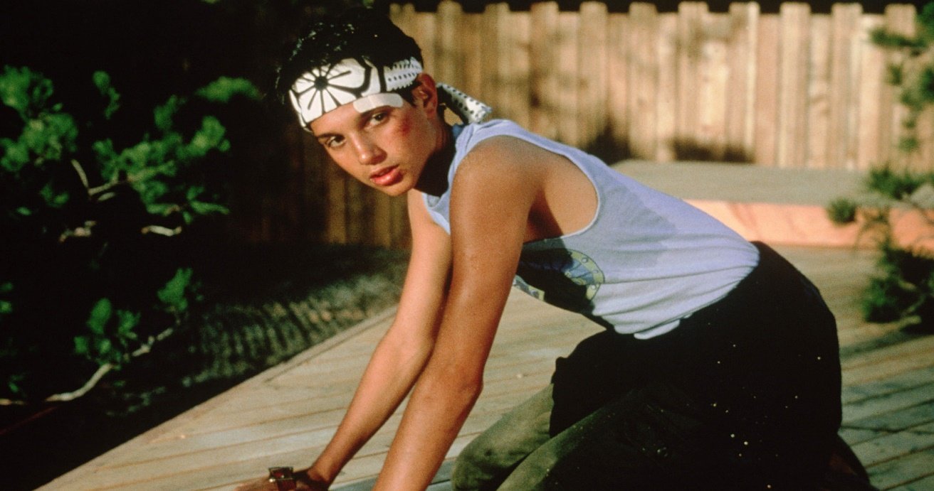

Slide 36
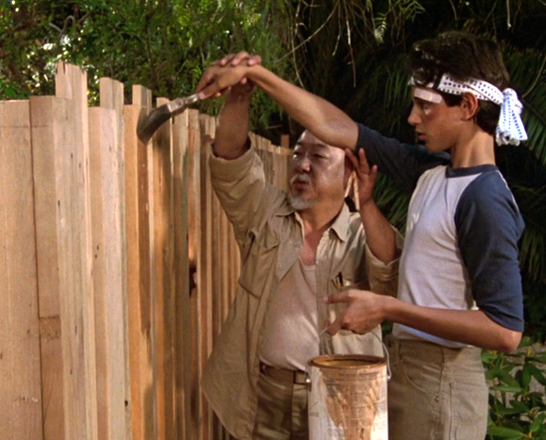

Slide 37
“The flour that you have will not run out. And the jar of oil will not run dry. Go back and bake me some biscuits.”

Slide 38
“Is this God’s judgment on me because I turned against the one true god, to these false gods? Elijah, did you come here so this would happen?”

Slide 39
God used these things to shape him into a true man of God.
God is using these things to shape you into a man or woman of God.

Slide 40
1 Kings 24
“The woman of God, He’d just raised
her son. She, she says to Elijah, “Wow! Now I know that you are a,” what? “Now I know you are, you are a man of God and the word of the Lord from your mouth is truth.”

Slide 41
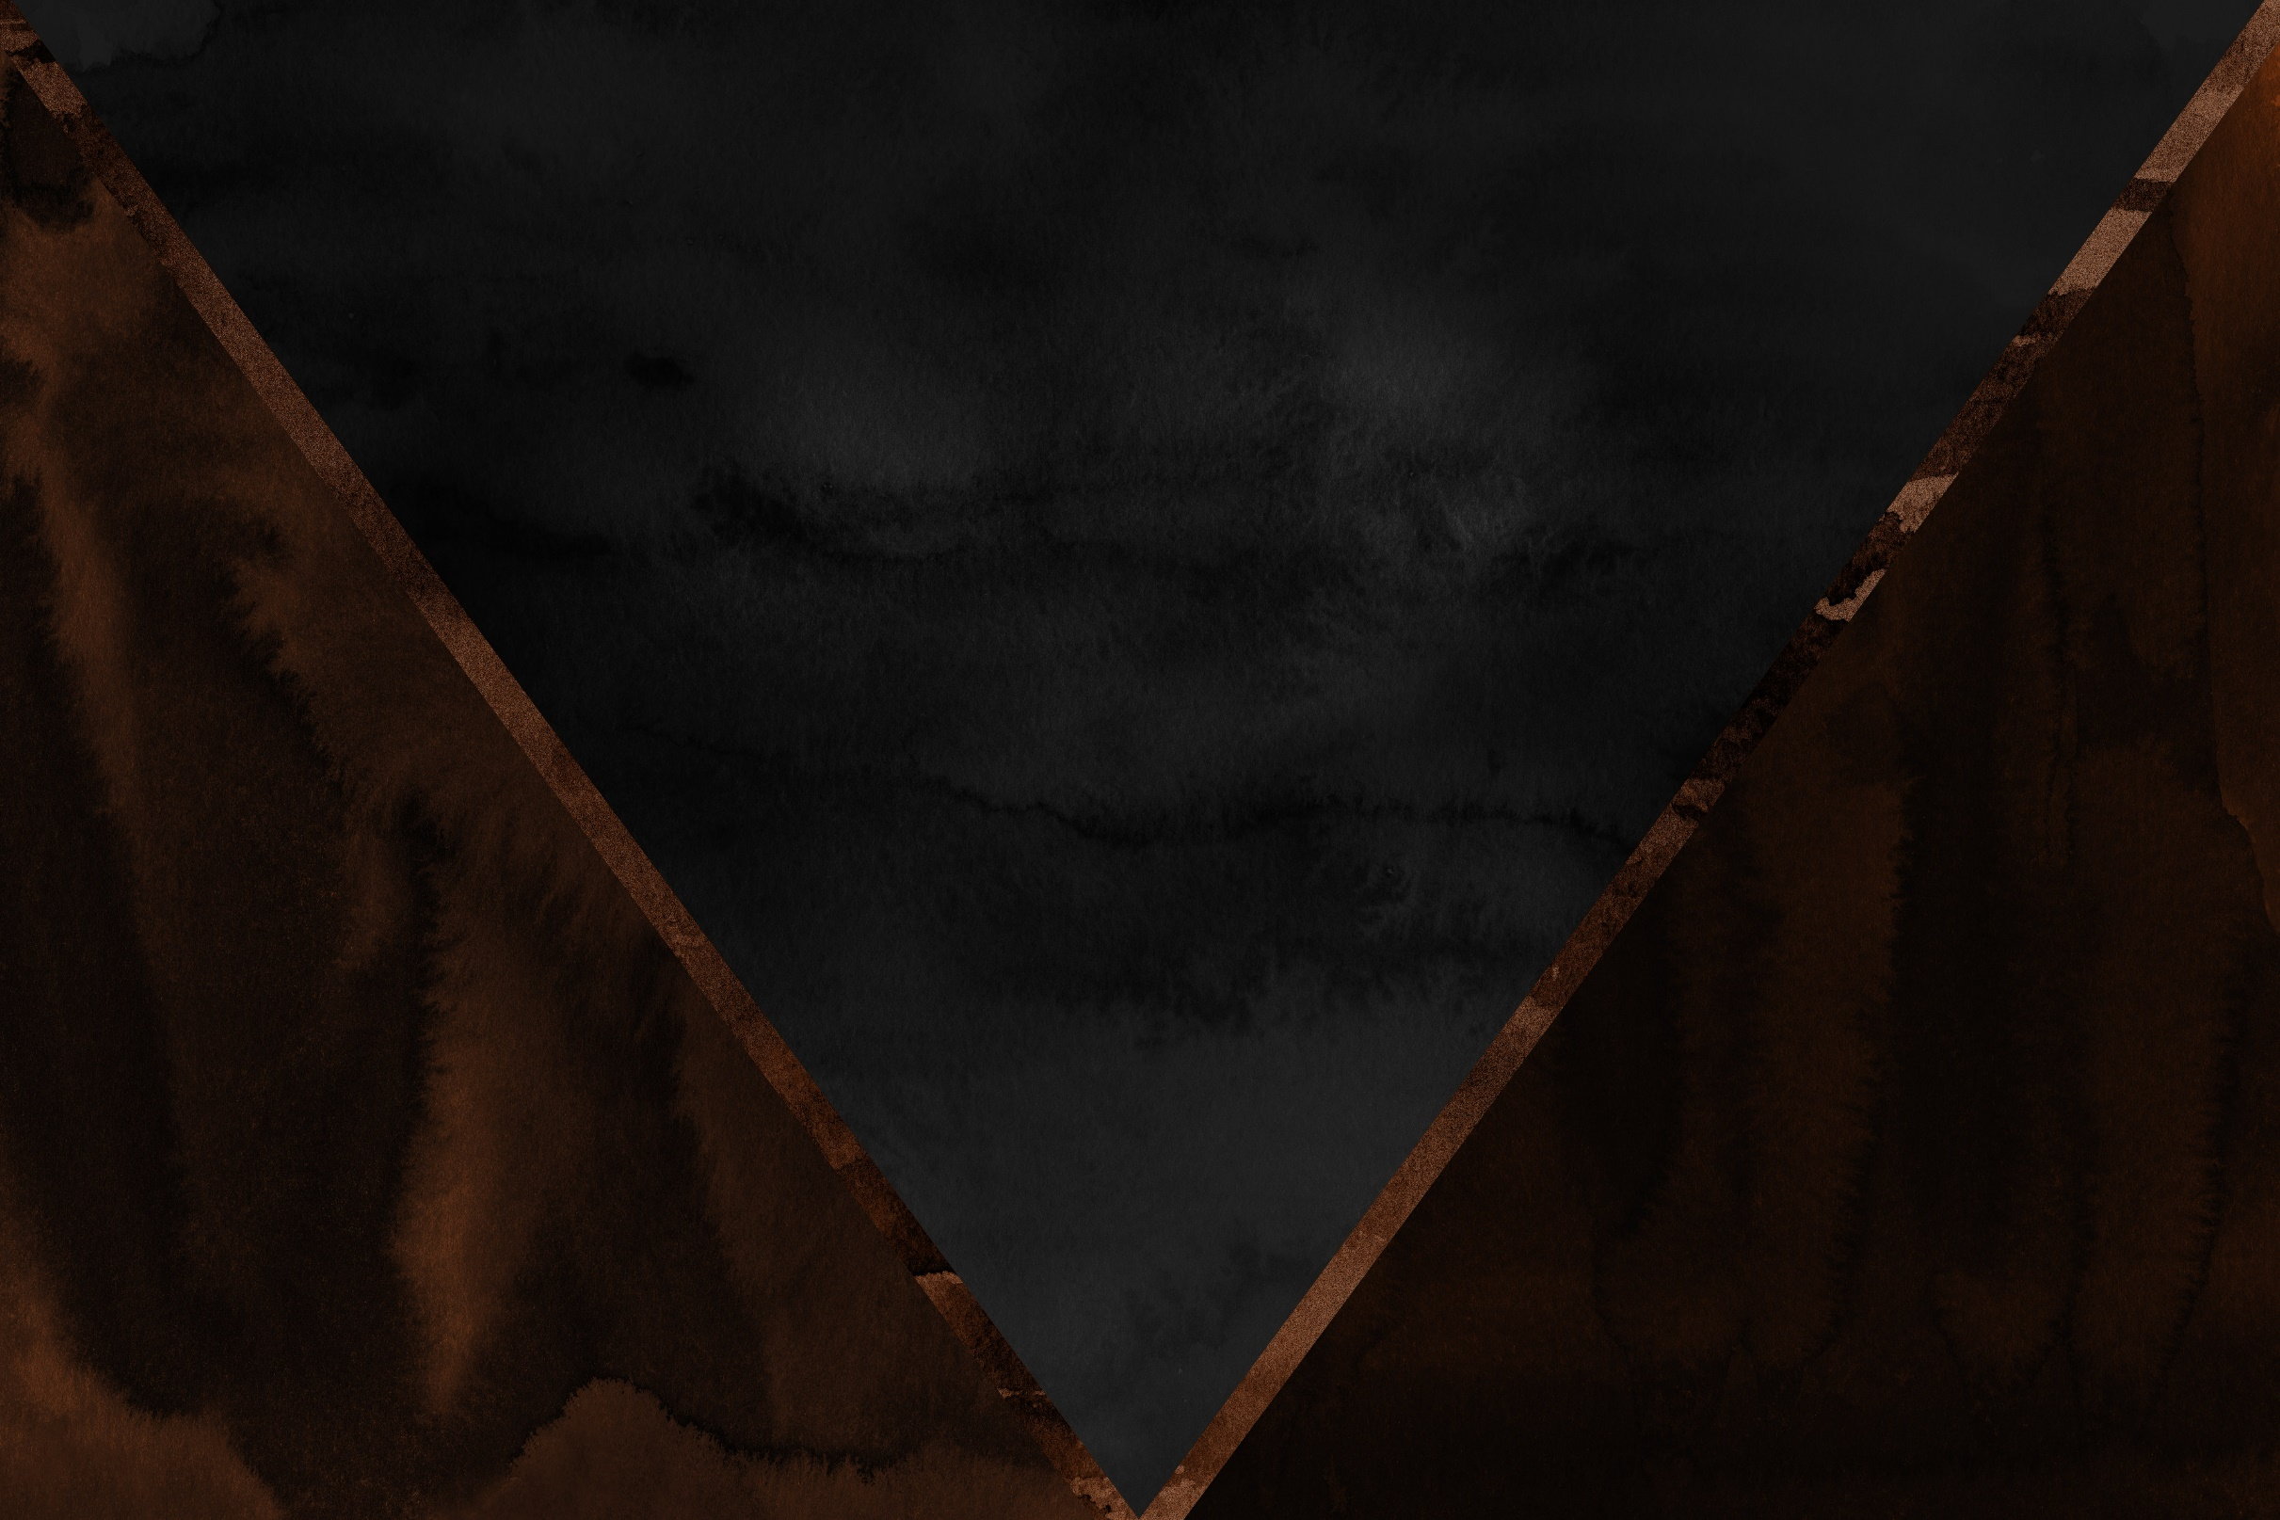
LET’S
PRAY

